Slide 1
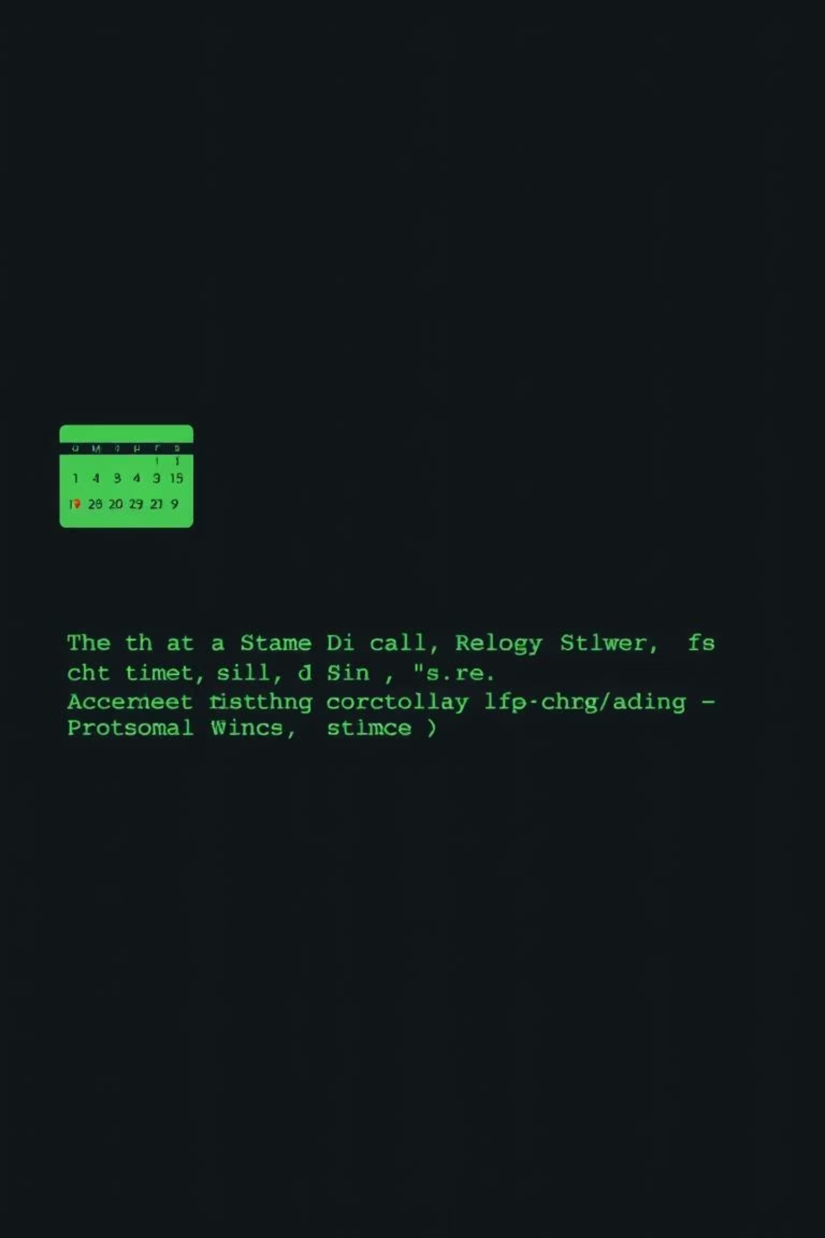
Calendar Management System in C
A command-line tool for managing calendars, events, and to-do lists.

Slide 2
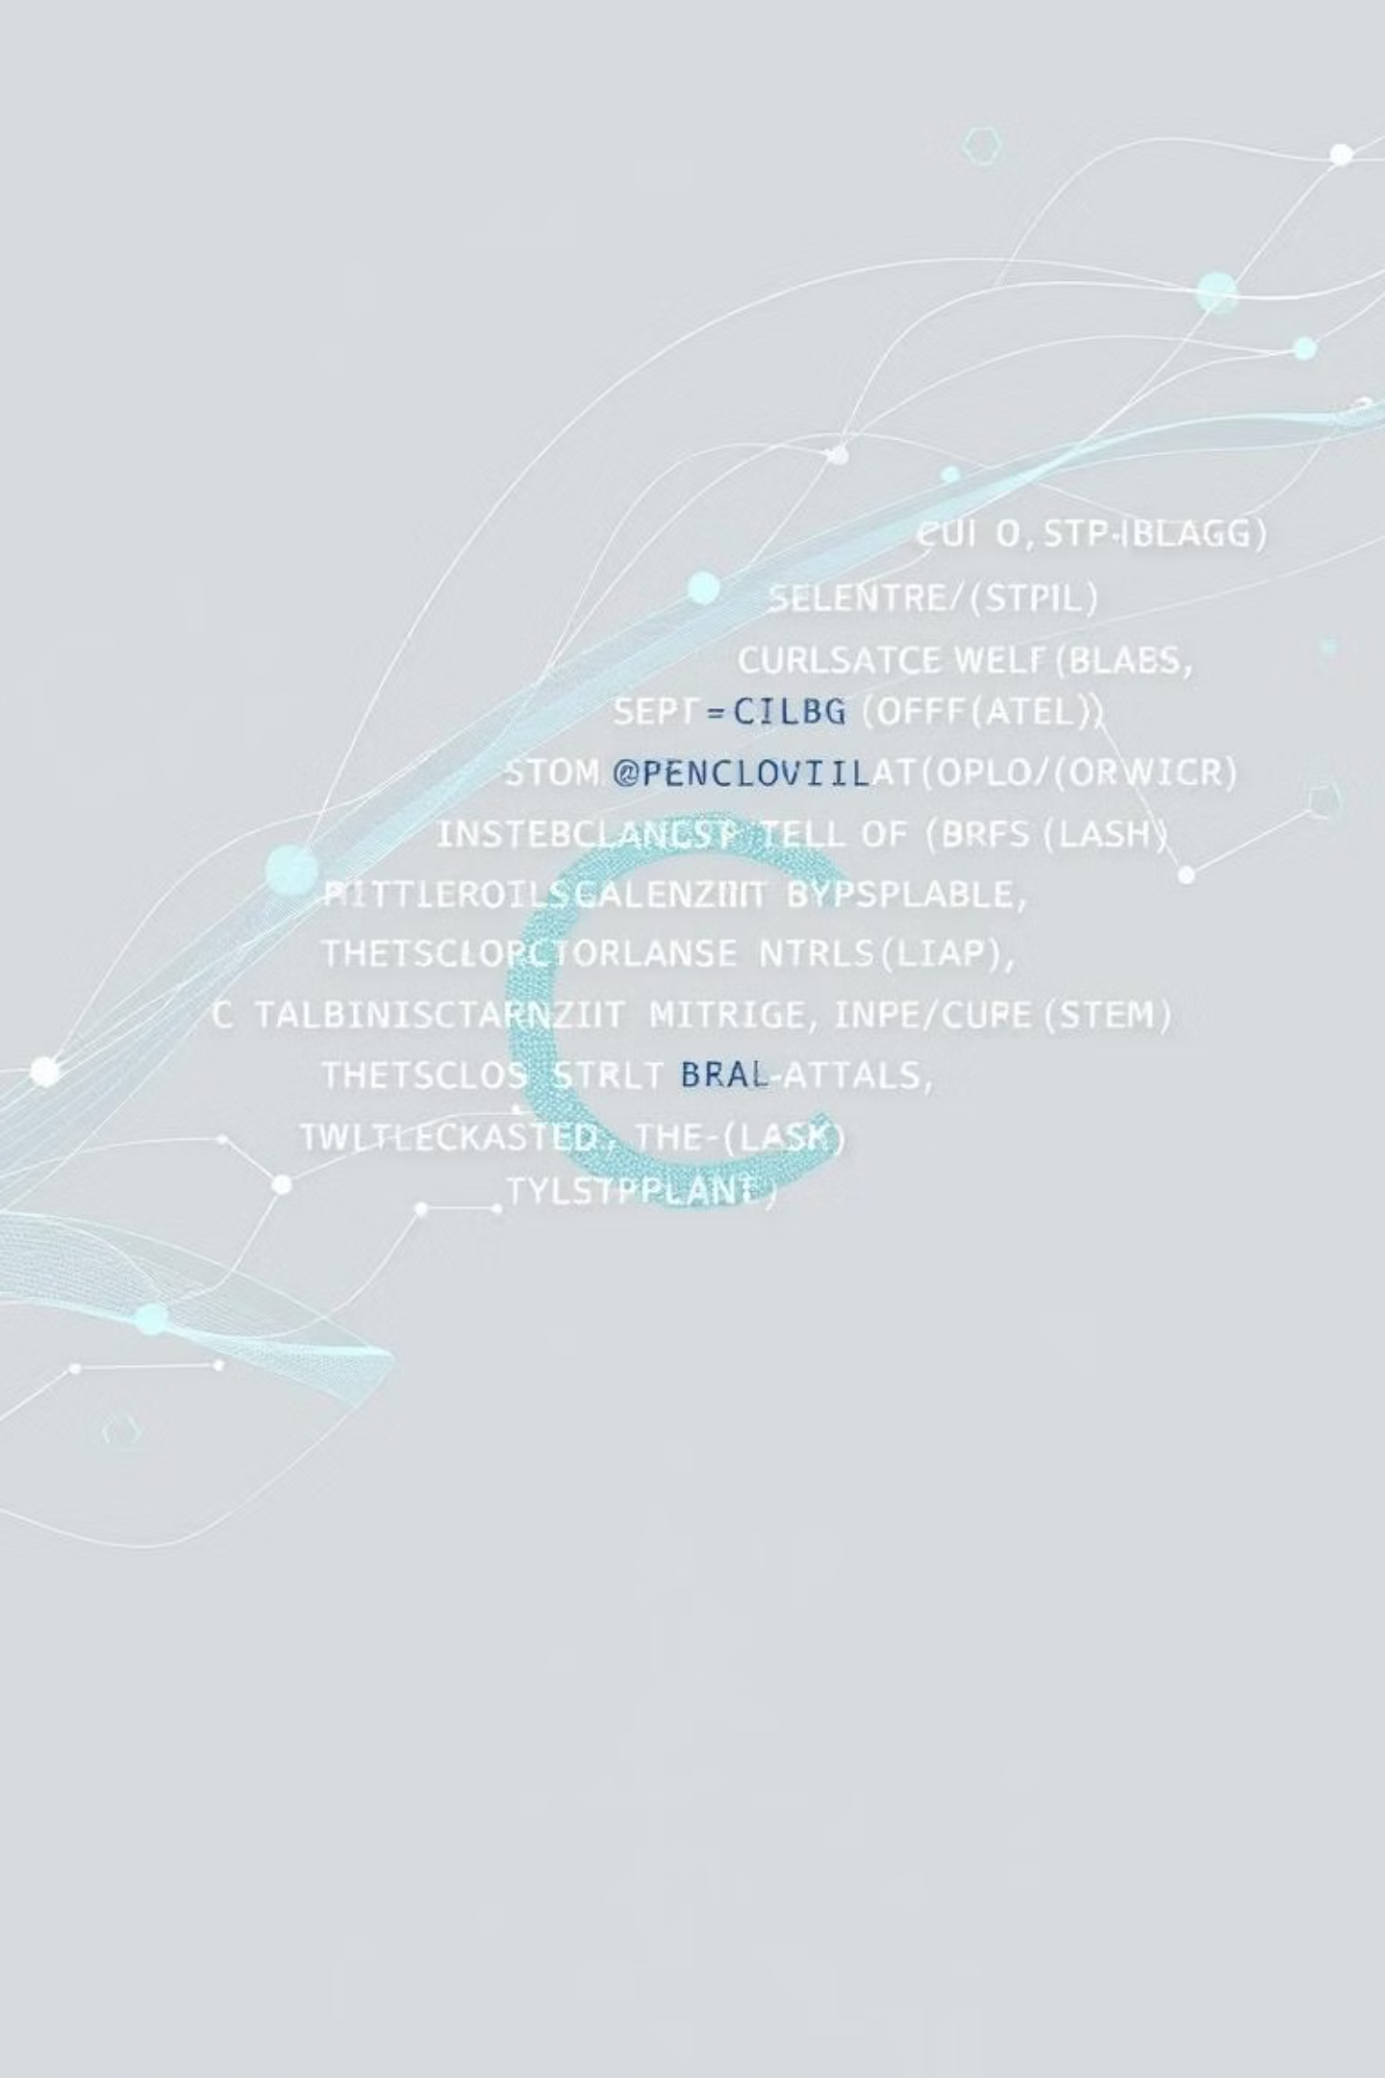
Application Overview
This C-based application allows users to view monthly calendars, add, view, and delete events, and manage a personal to-do list. It is built using standard C libraries like stdio.h, string.h, and time.h.

Slide 3




Calendar Feature
User Input
Users enter the desired year and month.
Date Calculation
Logic calculates total days since year 0 and checks for leap years.
Structured Output
Prints a clear, structured monthly calendar.
Key functions include main2(), checklp(), calcTotalDays(), and printCalendar().

Slide 4
Event Management
Add Event
Delete Event
Users input date and notes; past dates are restricted.
Removes a specific event by date.
View Event
Utilizes file handling functions (fopen, fprintf, fgets) for data storage and retrieval.
Displays all events stored in event.txt.

Slide 5

To-Do List Feature
Add Task
View Tasks
Stores new tasks in todo.txt.
Reads and lists all pending tasks.
Mark Task Complete
View Completed Tasks
Moves tasks to complete.txt and removes them from the pending list.
Displays all tasks marked as done.

Slide 6




Code Structure & Modularity
Separate Functions
Menu-Driven UI
Each feature is implemented with dedicated functions for clarity.
Clean and intuitive user interface using loops and switch cases.
File Handling
Effective use of structures and file operations for data persistence.

Slide 7

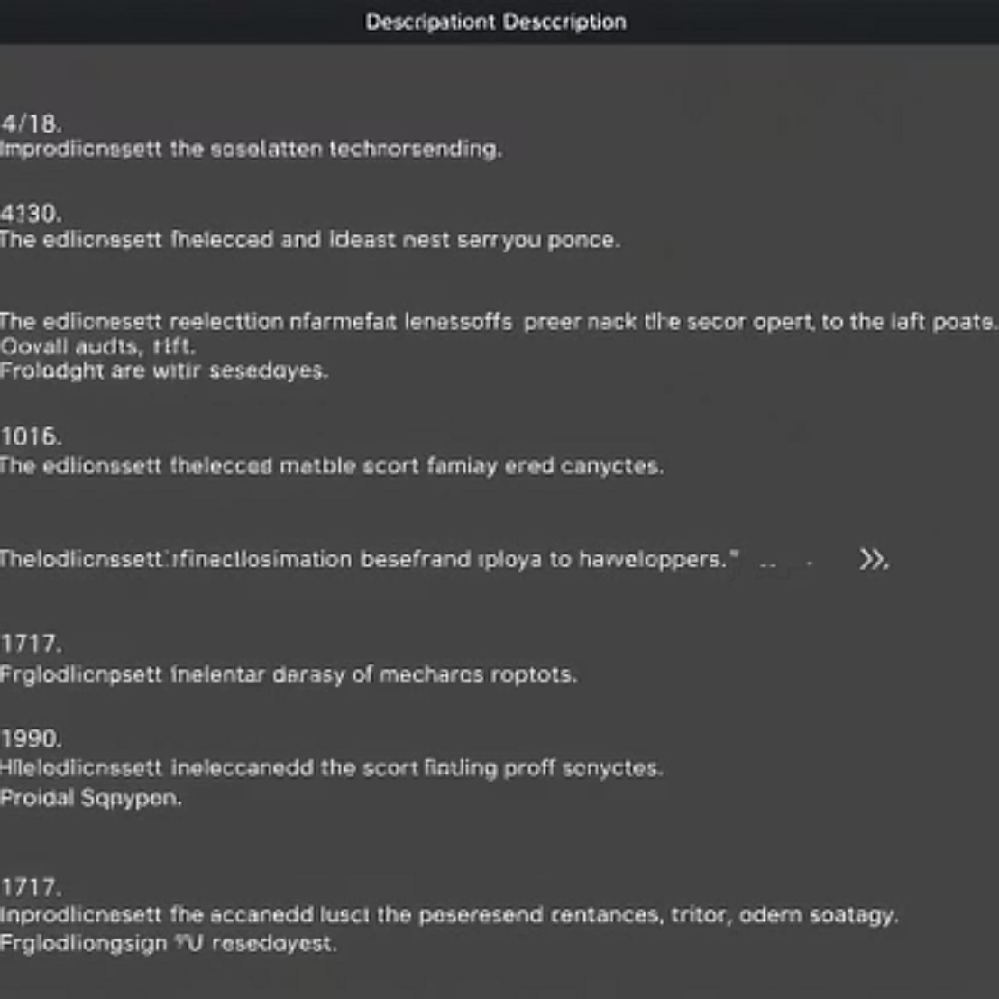
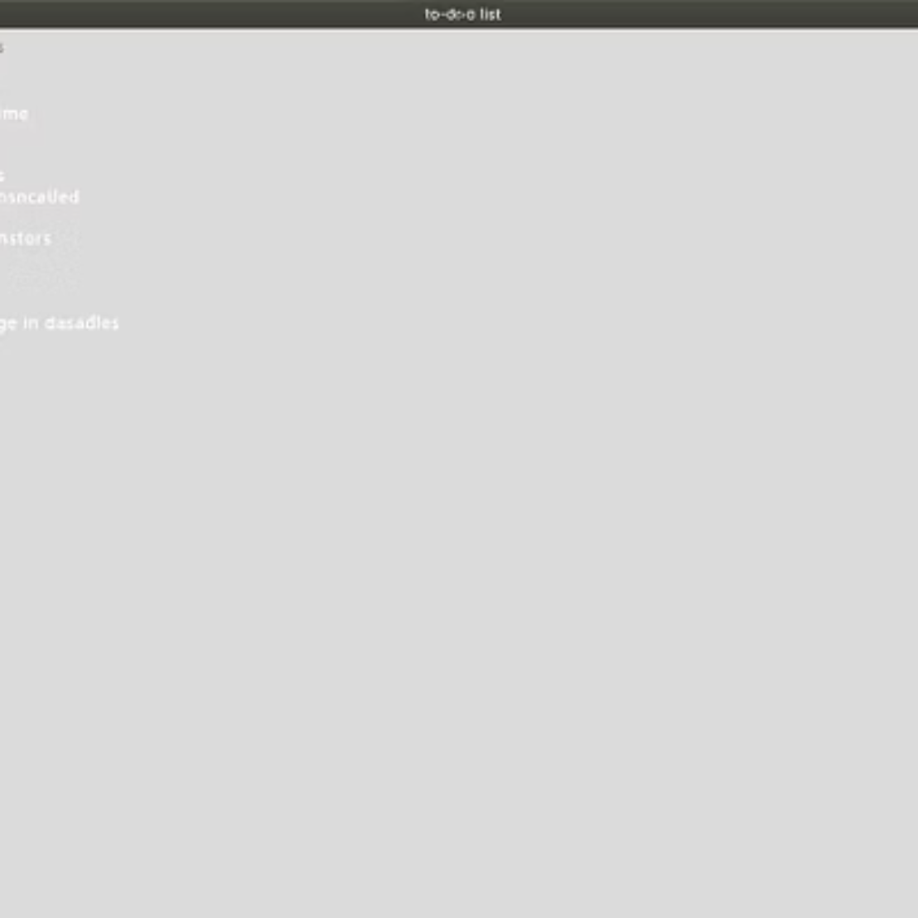
Sample Output
Visual examples of the text-based calendar, added/viewed events, and to-do list outputs.

Slide 8

Conclusion & Future Scope
This system is an excellent learning tool for beginners in C, demonstrating file handling and modular programming principles.
Future Enhancements
Graphical User Interface (GUI)
Event reminders
Recurring events

